Slide 1
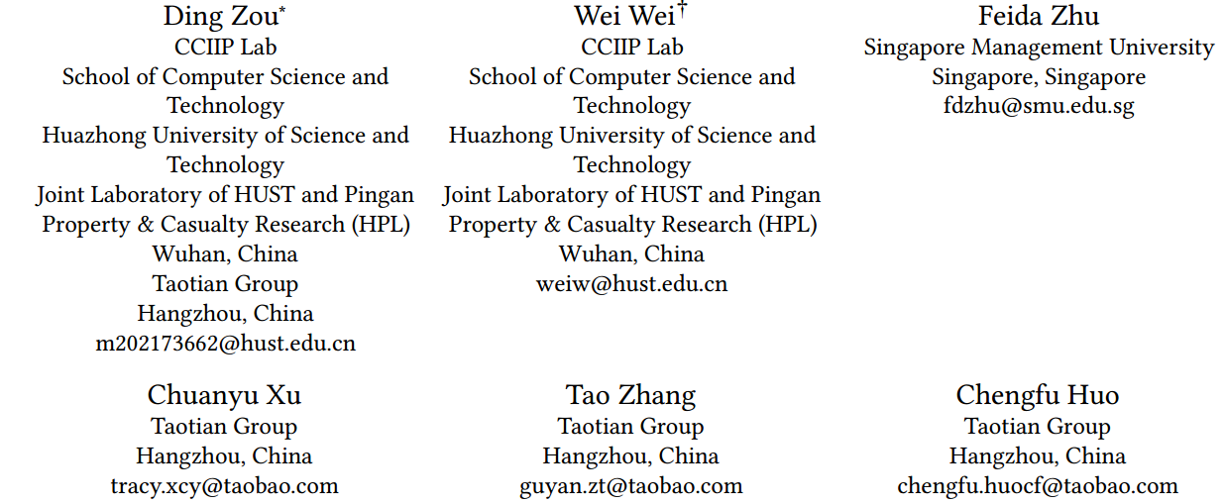
Knowledge Enhanced Multi-intent Transformer Network for Recommendation
（WWW-2024)
https://github.com/CCIIPLab/KGTN.
Reported by Ke Gan

Slide 2
1. Introduction
2. Approach
3. Experiments

Slide 3
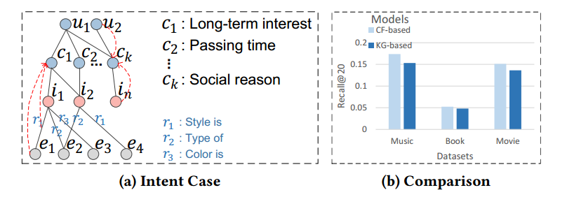
Introduction
1) users’ multiple intents underlying interaction behavior,users may have diverse intentions when shopping, such as long-term interest, passing time, or social reason,etc
2) redundant Knowledge information. In the context of user
intents, some knowledge facts in the KG may be irrelevant noise

Slide 4
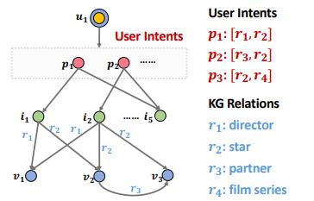
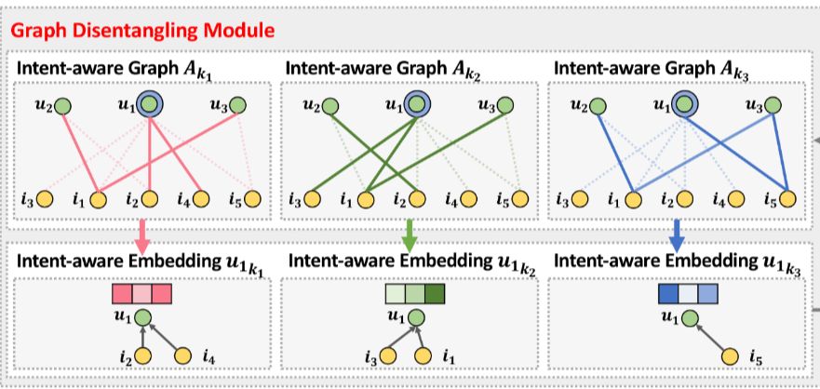
user intents may be composed of multiple heterogeneous information, including items, relations, and entities
SIGIR’2020 Disentangled Graph Collaborative Filtering
WWW’2021 Learning Intents behind Interactions with Knowledge Graph for Recommendation

Slide 5
Approach

Slide 6
Approach

Slide 7
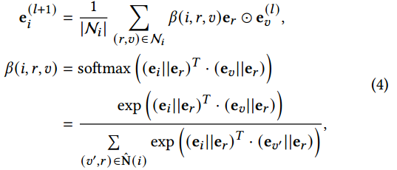
Approach

Slide 8
Approach

Slide 9
Approach

Slide 10
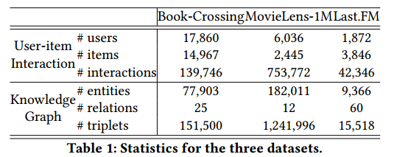
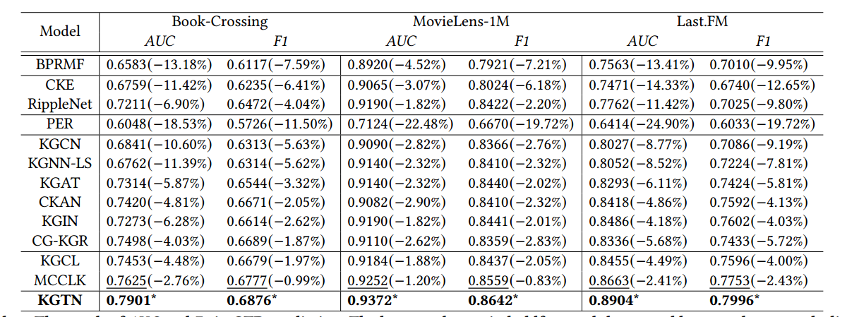
Experiment

Slide 11
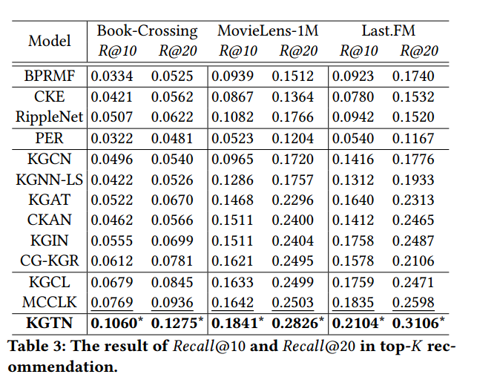
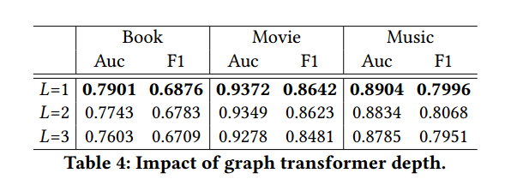
Experiment

Slide 12
Experiment

Slide 13
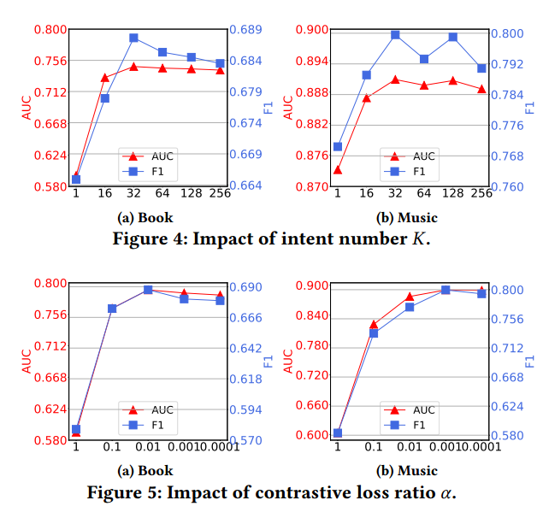
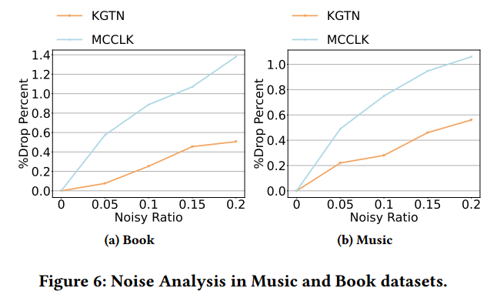
Experiment

Slide 14
Experiment

Slide 15
Thank you!

